Slide 1
RFT for clinical use
Niklas Törneke

Slide 2
The structure of the workshop
Basic assumptions: functional contextualism
Basic understanding of relational frame theory
Two areas of human experience as a direct effect of relational framing: Rule–following and experience of self
Psychological problems
Psychological treatment
PRACTICE WITH YOUR OWN CASES
And, please, participate with your own
experience, your own cases, questions,
suggestions and objections!

Slide 3
Functional contextualism
How is the phenomena of thinking dealt with, starting
from these assumptions?
CONTEXT
Thinking is behavior which is subtle or private and thus
hard to observe, except for the person doing it (and sometimes even…)
Thinking is a subtype of verbal behavior
Thinking can be understood using the same basic
behavioral principles as for understanding other behavior
Thinking can effect other behavior of the same organism as
in other behavior–behavior interaction
CONTEXT

Slide 4
Respondent
Unconditioned stimulus (US) Unconditioned response (UR)
Conditioned stimulus (CS) Conditioned response (CR)
Operant
Antecedent Behavior
Consequence

Slide 5
RFT; one central idea
Human languaging and cognition consists of a specific kind of learned behavior:
A particular way of relating stimuli

Slide 6
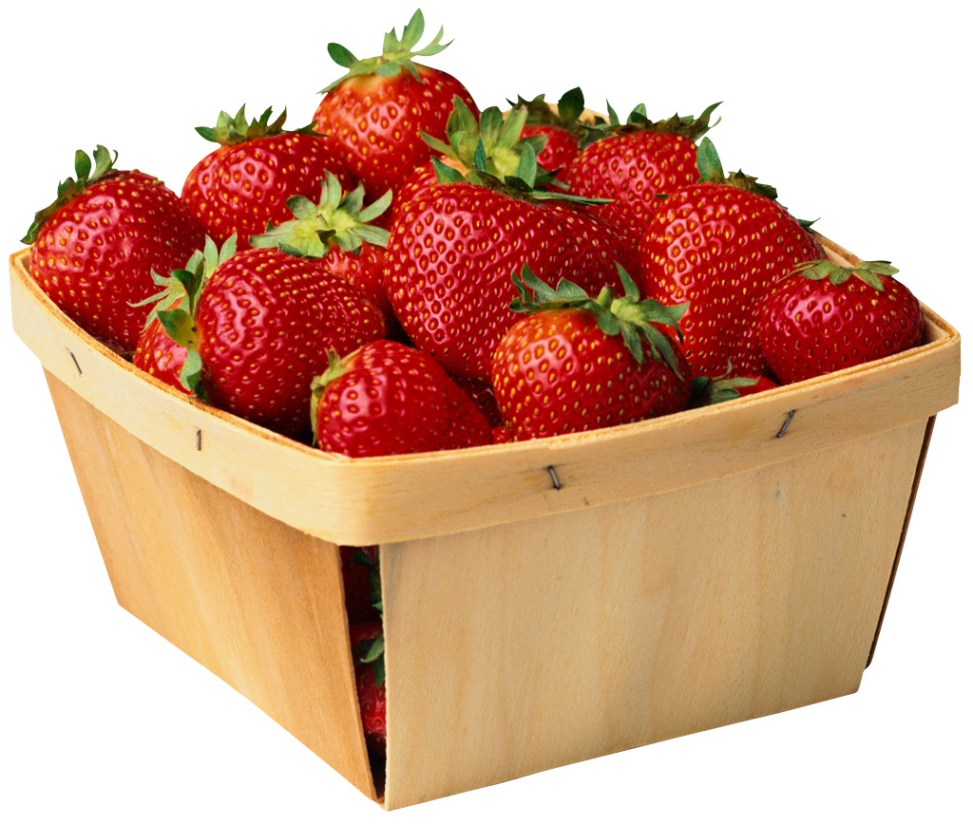
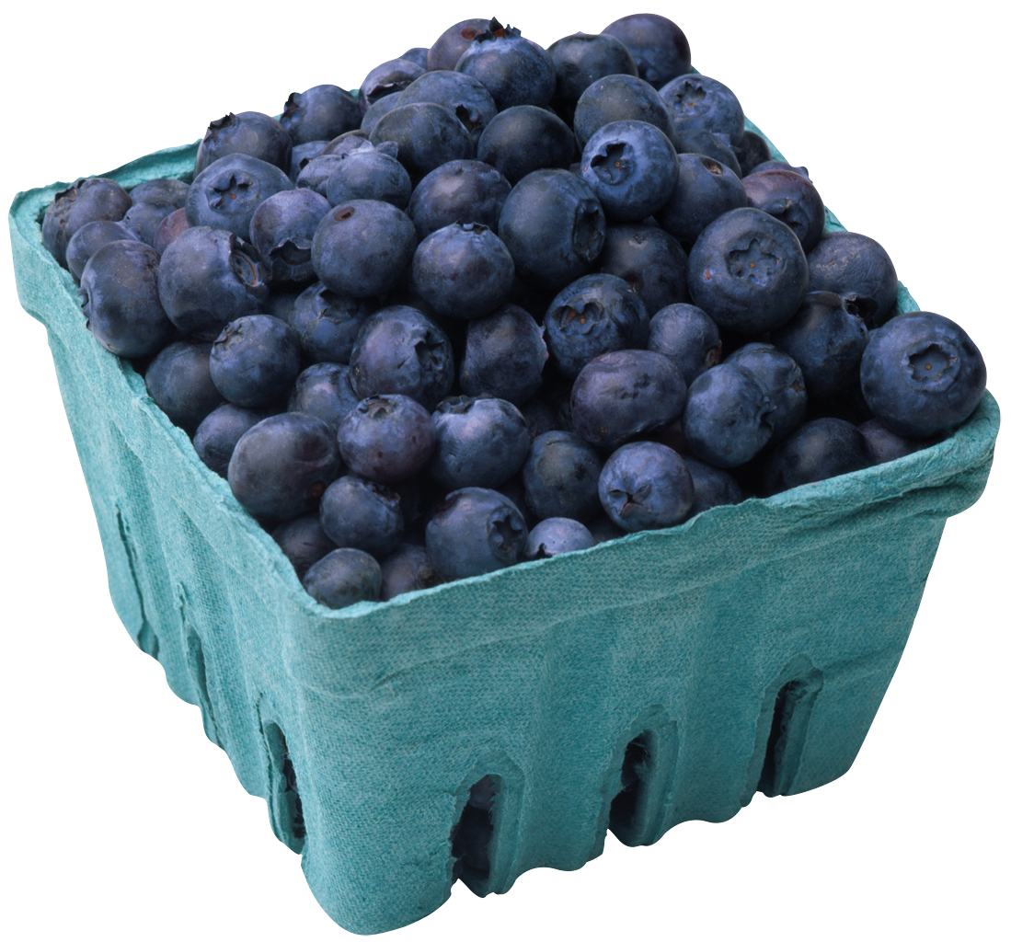
Relating controlled by the phenomena related

Slide 7
Relating controlled by arbitrary contextual cues
Humans teach their offspring to abstract arbitrary stimuli (sounds, words, gestures) to controll relations and thereby alter stimulus function
>
=
is more than
is the same as
is the same as 10000 euros
is the same as a hard punch on the nose

Slide 8
Relating controlled by arbitrary contextual cues
LESS THAN
MORE THAN

Slide 9
Different relations
AFTER
IN FRONT OF
LESS THAN
MORE THAN
BEFORE
BEHIND

Slide 10
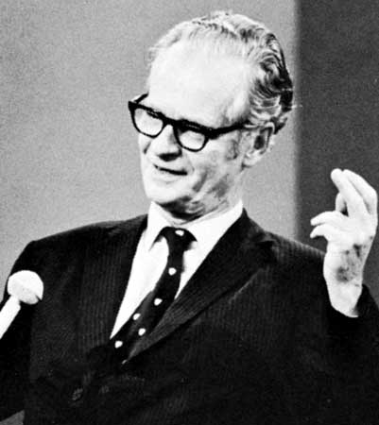
Relating controlled by arbitrary contextual cues
This particular kind of relating is called:
Arbitrarily applicable relational responding
Derived relational responding
Relational framing
is outside of
is inferior to
is greater than
comes after
is the opposite of
from the perspective of
is the same as
is a part of

Slide 11
An exercise
In what way is…
One list Another list
1. 1. behind 1. ?
2. 2. longer than 2. ?
3. 3. before 3. ?
4. 4. better than 4 ?.
5. 5. inside 5. ?
6. 6. same as 6. ?
7. 7. part of 7. ?

Slide 12
An example of special importance: Deictic framing
Here /There
I /You
Now/Then
Left and right
As a result we have the “fromeness” of human experience: a particular experience of perspective which is a result of the ability to interact with arbitrary contextual cues
I – HERE – NOW
Deictic I
(Self as perspective, self as context)

Slide 13
The effects of relational framing
For a human being anything in the context can obtain functions due to social whim
The very behavior of humans (even private, subtle behavior) can obtain functions due to social whim
Two areas of special importance: The ability to follow instructions (rule following) Interaction with your own behavior (self)

Slide 14
Rule following
All is changed when stimuli (part of the context)
can acquire function (effect on behavior) in a new way!
“Turn left at the next traffic light, drive one kilometer and take first right
after the petrol station and then you will see the football arena straight ahead”
“Make sure you sleep, otherwise you will be ill”
“If you go to bed now you will have a surprise tomorrow”
“If you do that again I will go away and never come back”
“Find out why you are anxious and the anxiety will go away”
CONTEXT
A
B
C
CONTEXT

Slide 15
Interacting with your own behavior
CONTEXT
CONTEXT

Slide 16
Interacting with your own behavior (self)
Training verbal self–discrimination/talking about your own responding
Self as ongoing process
Self as concept, content or story
Self as perspective or context
In simple words:
I learn that I am “I” and that my own subtle responses, such as thinking and feeling, are part of but not identical to “I”
In technical words:
I learn to frame my own responses in perspective from and in hierarchy with the deictic I

Slide 17
The joint venture of rule following and interacting with your own behavior:
The human ability to instruct yourself and act on your own instructions; following self-rules

Slide 18
The risks of relational framing
To sum it up:
Your own verbal behavior can trick
you into doing things that will not
work well for you!
The interface with pain will increase enormously
Following instructions: direct experience can be overruled
Sensibility to social whim is built in
The risk of getting stuck in vicious circles when following instructions

Slide 19
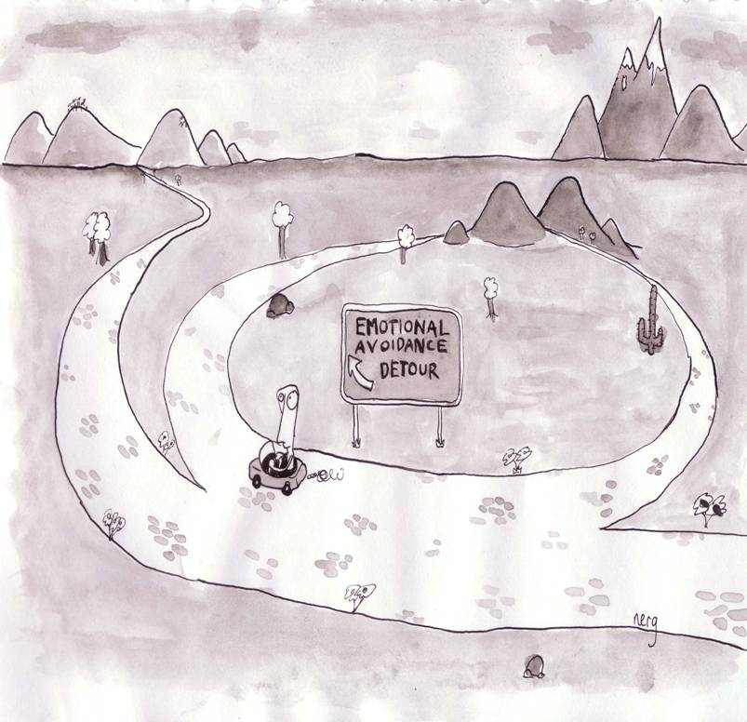
Flexibility
Psychological treatment informed
by relational frame theory:
ACT
Rigidity
Notes:
Repeat some of the examples from slide 16

Slide 20
Flexibility:
Psychological flexibility is the ability to notice and react to your
thoughts, feelings, and behaviour in order to give one the
opportunity to take action towards important ends.
More specifically this involves responding to one's own responding
as participating in a frame of hierarchy with the deictic “I.” This is
typically accompanied by a substantial reduction in the behavioural
control functions of the response in question, which thereby allows
for additional relational responding that specifies appetitive
augmental functions, and further behaviour that is coordinated
with that relational responding

Slide 21
Rigidity:
Fusion
Experiential avoidance
Fusion: Not distinguishing, in the moment, “I” from subtle/private self–instructions (your own responses)
Experiential avoidance: Following of self–instructions to control, extinguish or lessen private responses such as feelings, thoughts, memories and bodily sensations

Slide 22
Two clinical cases

Slide 23
Clinical case 1.
Claus, 45. Married, two teenage daughters. Works as a translater. He has had his problems since his own teens and thinks they relate to his own upbringing in a very strict, punishing family situation. No physical abuse. He often isolates himself at home, focusing on his work and for weeks at a time he only sees his own family. In other periods he does see some friends, colleagues and business contacts. In these situations he is always very tense and anxious. He often cancels meetings like these, finding different excuses When he goes he “suffers through”, all the time very focused on acting so that others will not give him any attention. He also describes that he is very aware of his own bodily sensation (sweating, heart palpations) acting to keep them under control so that others will not see that he is not feeling well. Afterwards he often does not remember well what happened at the meeting, describing himself as “mentally blank”. He often leaves early, finding some excuse.
In the dialogue with the therapist Claus gives good emotional contact, very troubled by his problems. He is highly self-critical.
Experiential avoidance?
Isolating himself, canceling meetings and giving excuses.
In the threatening situation: acting to avoid attention, focusing on his own bodily sensations sensations to control them, leaving early and giving excuses
Fusion?
Acting on specific thoughts about danger in what others might see or think, on assumptions about himself and others, acting on rules about the necessity to control private events to live his life well.

Slide 24
Clinical case 2
Sara, 35, problems with aggression both within and outside of the family. Married, two children 8 and 10 years old. Works as a consultant within a IT company.
Sara tells you that as long as she remembers she has had a “bad temperament”. For the last few years this has been a growing problem. She gets furious and verbally attacks both her kids and her husband. She thinks these outburst are unreasonable and she is worried about the consequences for the children in the long run. These outburst of anger comes in everyday situations, for example when the kids don’t do as she tells them to. She often tries to reason with the children explaining to them why they should behave in a certain way and gets furious when they don’t accept her arguments or simply don’t comply. In other social situations similar things happen. On and off she yells at customers who causes her trouble and the same thing happens in shops and restaurants. She thinks that those she yells at usually behave in a stupid or incompetent way but at the same time she realizes her own reaction to this is unreasonable and also can have problematic consequences for herself.
Sara does not think she is under any unusual pressure at the moment and is not tired or stressful more than for short episodes. She is very fond of her family and likes her work. What troubles her is her outbursts of anger and the different problems this causes.
Experiential avoidance?
Can the outbursts of anger in themselves be an instance of experiential avoidance?
In that case the client is avoiding thoughts, feelings etc that would turn up if
the outbursts where blocked
Fusion?
Acting on specific thoughts about what it would be like if others where allowed to
continue their behavior. Acting on assumptions about what it would mean if others
don’t agree or hold other views.
.

Slide 25
Three clinical tasks
Help the client discriminate the relationship between current functional classes of behaviour and problematic consequences. According to the analysis done we expect the problematic functional class to be responding in coordination with self-instructions/rules.
Help the client discriminate his/her own responses and frame them in perspective and hierarchy with the deictic I and train this repertoire as an alternative functional class.
Help the client specify appetitive augmental functions for further behaviour

Slide 26
C
B
B
A
C

Slide 27
Tools for therapy
Functional analysis is at the root of ACT
Metaphor
Experiential excercises

Slide 28
Experiential exercises in ACT
Push away – have in your lap
Don’ think of…
Jumping
Acting in the presence of contradicting verbal responses
The pen through your hand?
”Who is noticing that?”
Leaves on a stream
Out on the floor, up on the wall
Distancing exercise
Your own funeral
Write the script for the TV series about you

Slide 29
Metaphors in ACT
Digging a hole
Using a spit with a big stone
Driving with passengers
Thinking machine, the mind
We are four in this room…
Pop – ups
Looking at an aquarium
Leaning forward when skiing
Through the city – to the train
Breathing in a bad smell – for something
Walking on a blue floor
Trust your feet

